Slide 1

ROLLS THEOREM , MEAN VALUE THEOREM
Prepared by
Md Saif Kabir
Lecturer,OAA

Slide 2
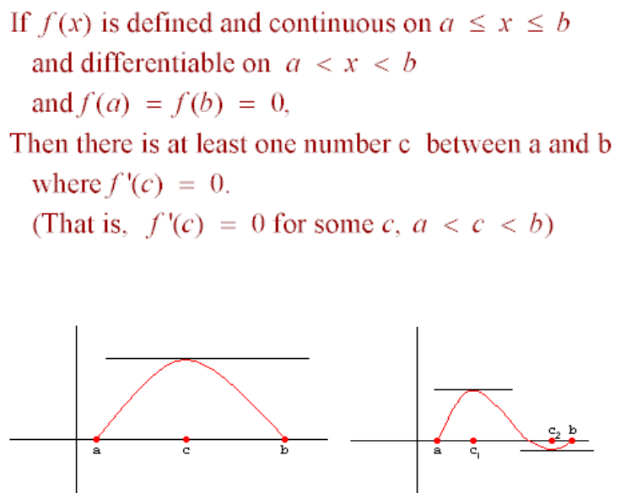
ROLLS THEOREM

Slide 3
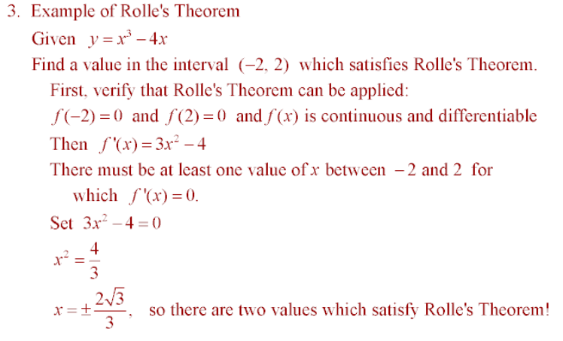

Slide 4
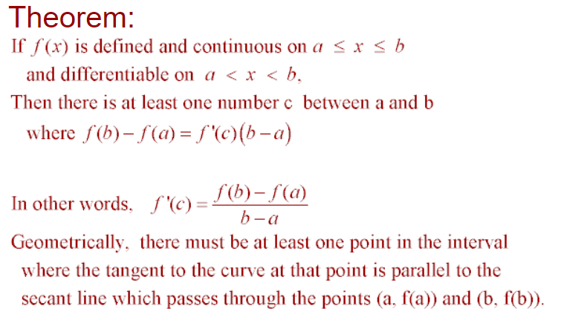
MEAN VALUE THEOREM

Slide 5
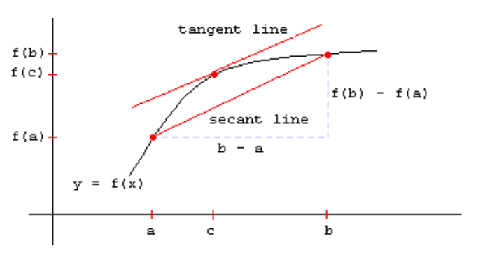

Slide 6
